Slide 1
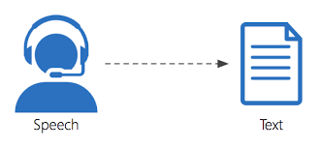
Accentuate: Enhancing Speech-to-Text Accuracy Across Diverse Accents
By: Anthony Lee and Hrisha Yagnik
Advisor: Dr. Fatema Nafa
DS5500 Capstone Project Presentation

Slide 2
Objectives
Mastering GitHub for Proficiency in Version Control
Acquiring Skills in Audio Data Processing
Proficiency in Document Preparation with LaTeX
Attaining Advanced Proficiency in Python Programming
Initiating Project Work with Introduction to Natural Language Processing (NLP)

Slide 3
Problem Specification
Project Goal:
Develop an audio-to-text converter for transcribing spoken English with diverse accents.
Problem Statement:
Our project's main goal is to create a sophisticated audio-to-text converter that can transcribe spoken English with a variety of accents. This tackles a major issue in the state of speech recognition technology today, where the majority of systems show a noticeable decline in performance when handling regional or non-standard accents
Desired Result:
Input: Audio file of accented speech and accompanying text
Output: Transcript of audio file with accuracy score (0-100%)
Notes:
Project Goal:
Develop an audio-to-text converter for transcribing spoken English with diverse accents.
Problem Statement:
Our project's main goal is to create a sophisticated audio-to-text converter that can transcribe spoken English with a variety of accents. This tackles a major issue in the state of speech recognition technology today, where the majority of systems show a noticeable decline in performance when handling regional or non-standard accents. Developing inclusive and accessible speech recognition systems requires the ability to process and interpret different English accents, particularly in a global context where English is spoken with a wide variety of accents.

Slide 4
Related Works
Self-Supervised Learning-Based Source Separation
Improved transcription accuracy in multi-speaker scenarios using WavLM model integration with self-supervised learning.
Accented Text-to-Speech Synthesis With Limited Data
Developed a framework for synthesizing accented speech with limited data, enhancing speech quality and accent similarity.
Multi-Accent Speech Recognition with Unsupervised Accent Modeling
Proposed global embedding methods like VAEs and GSTs to enhance speech recognition across diverse accents
Connections to our project:
Implement self-supervised learning for transcription accuracy in multi-speaker environments.
Enhance text-to-speech synthesis quality and accent adaptation using limited data techniques.
Explore global embedding methods to improve speech recognition across varied accents.
Notes:
Input:
Speech audio from various speakers of different ethnicities and gender. These audio clips are individuals reading snippets of texts out loud. These audio clips may vary in length and audibility due to the person speaking depending if the speaker has a more monotone or fluctuating voice.
Output:
Generated text from audio file and Textual Accuracy score. The expected output of this project is to generate a .txt file containing the textual output from the given speech audio. Moreover, the generated text file should be accompanied with an accuracy score that will be from 0 to 100% that details a comparison score of how accurate the generated text is to the original text that the speaker was reading.

Slide 5
Amendments
Objective: To enhance the development of an audio-to-text converter that accurately transcribes varied English accents.
Reasons for Amendments: Updates were necessitated by initial testing feedback, evolving project requirements, and new insights into accent diversity's impact on speech recognition accuracy.
Description of Amendments: Originally, the project used basic acoustic models for transcription. The approach has been revised to incorporate advanced neural network models like facebook/wav2vec2-large-robust-ft-swbd-300h for better performance across diverse accents.
Impact of Amendments: These changes have broadened the project's scope to include more sophisticated machine learning techniques, extending the timeline and increasing the budget. However, they promise significantly improved transcription accuracy, potentially setting new standards for inclusivity in speech recognition technology.

Slide 6
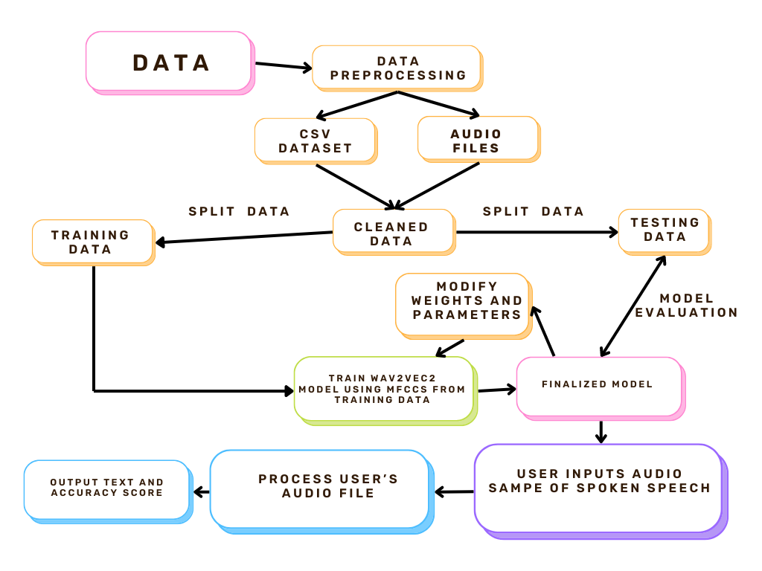
Methodology

Slide 7
Tools List
Hardware:
CPU: Intel Xeon CPU with 2 vCPUs (Google Colab)
RAM: 12 GB RAM
Software:
Python 3
Libraries: os, zipfile, pandas, matplotlib, librosa, numpy, torch, scikit-learn and transformers
Version Control: Github and Google Colab

Slide 8
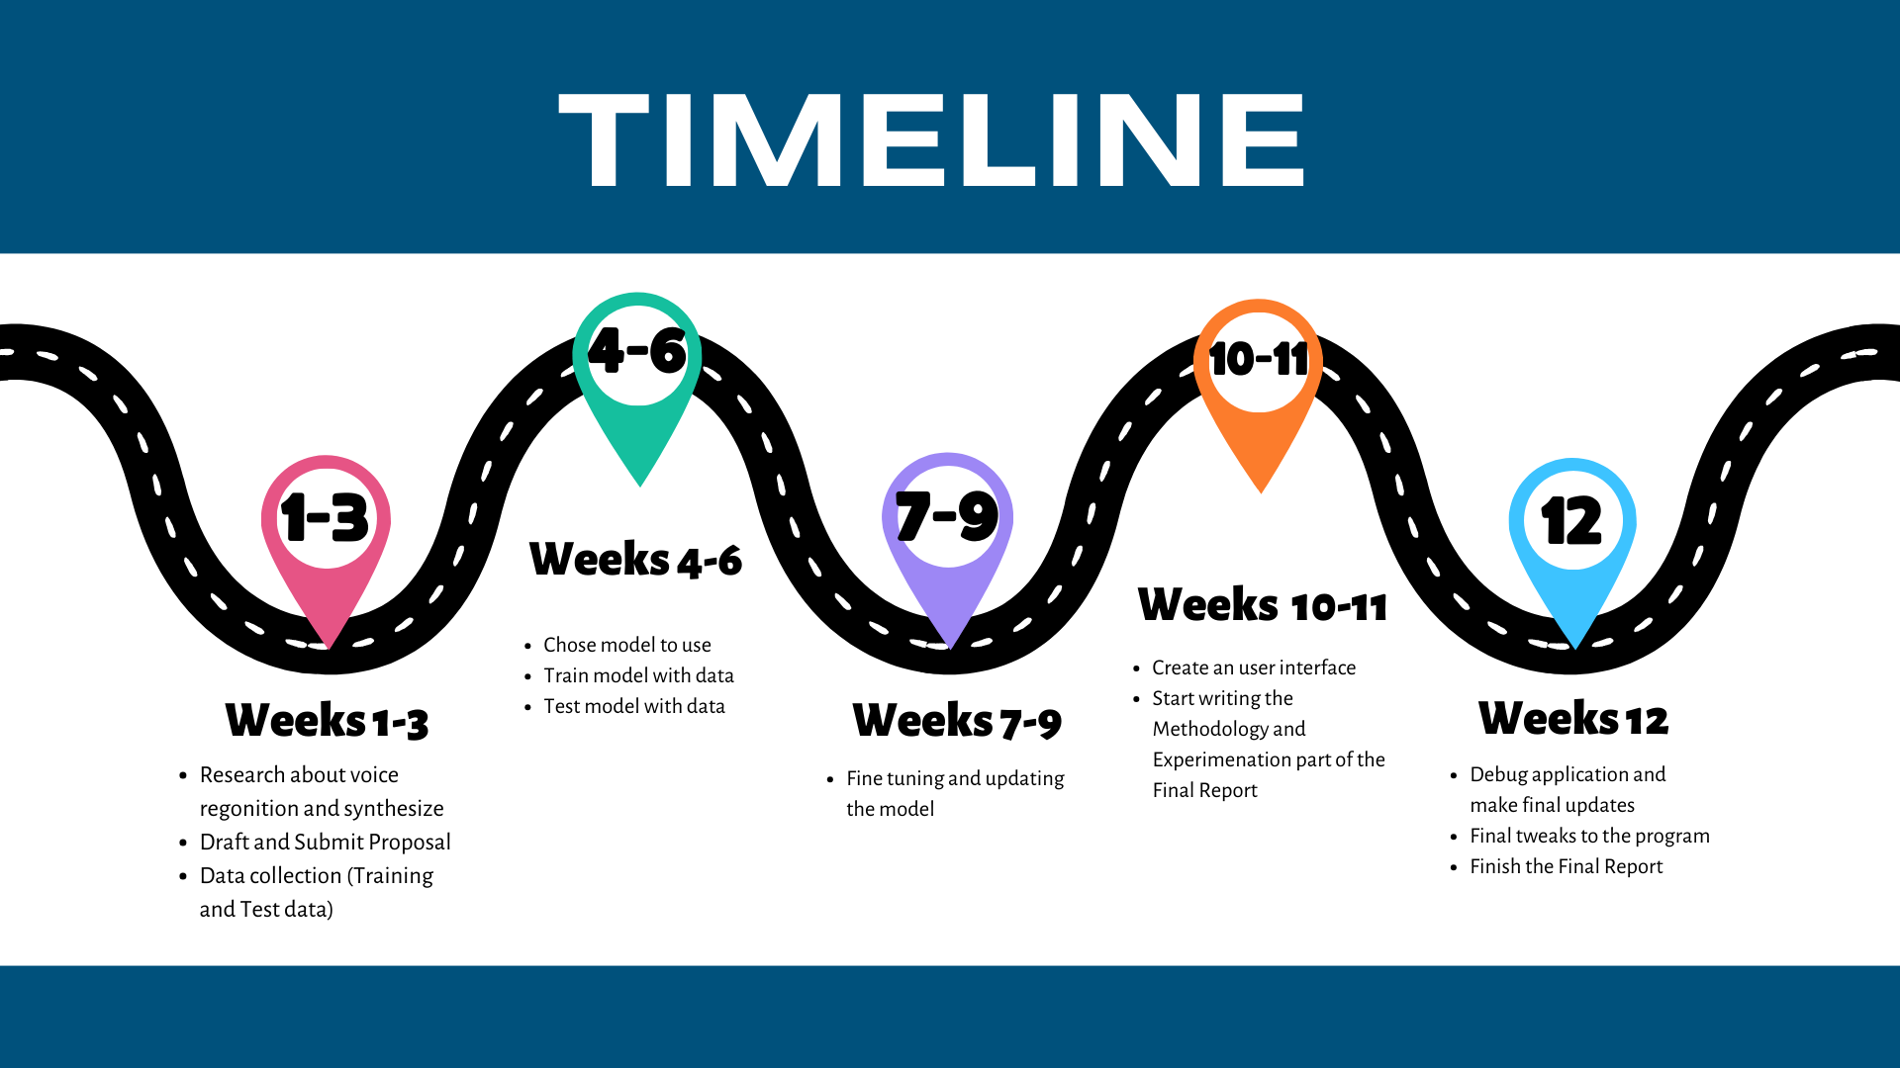
Time Schedule

Slide 9
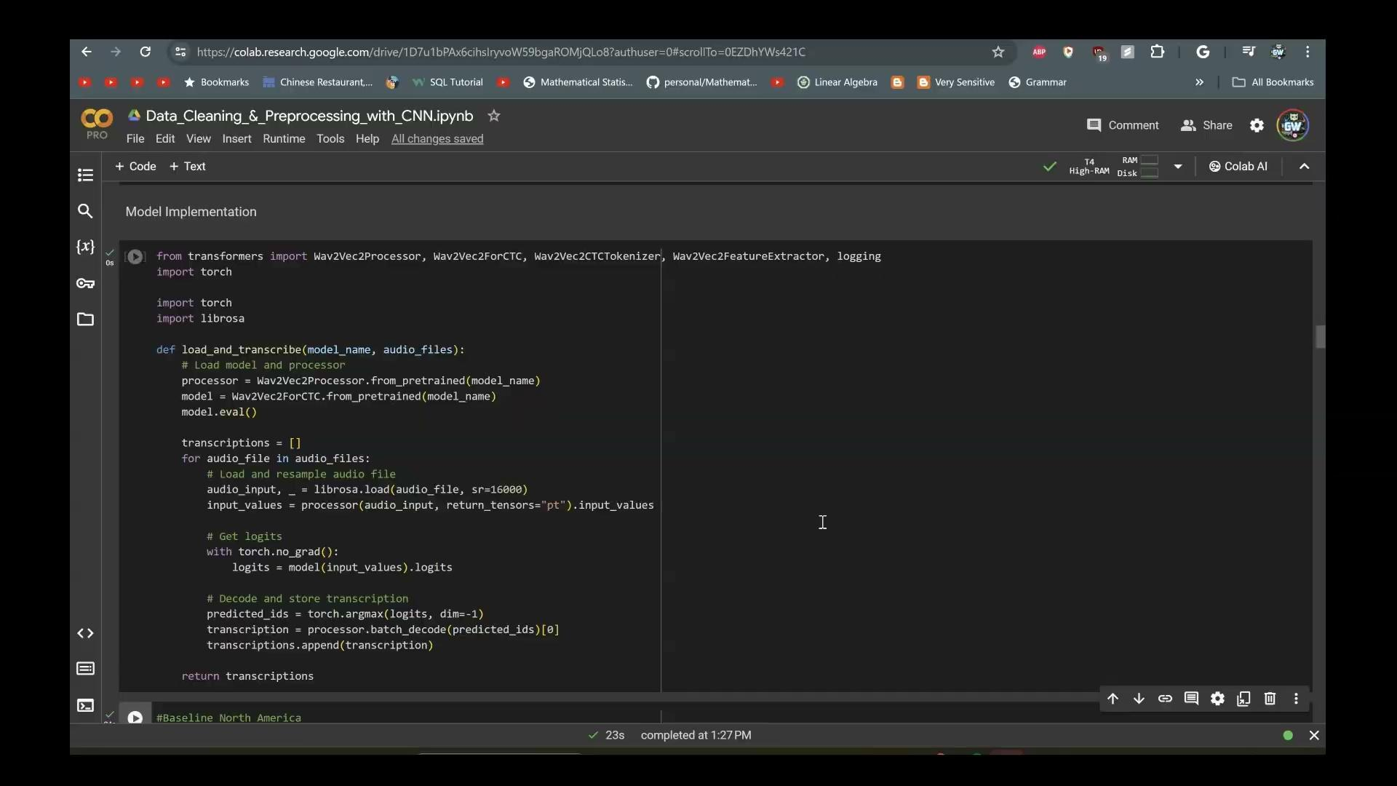
Demo (code)

Slide 10
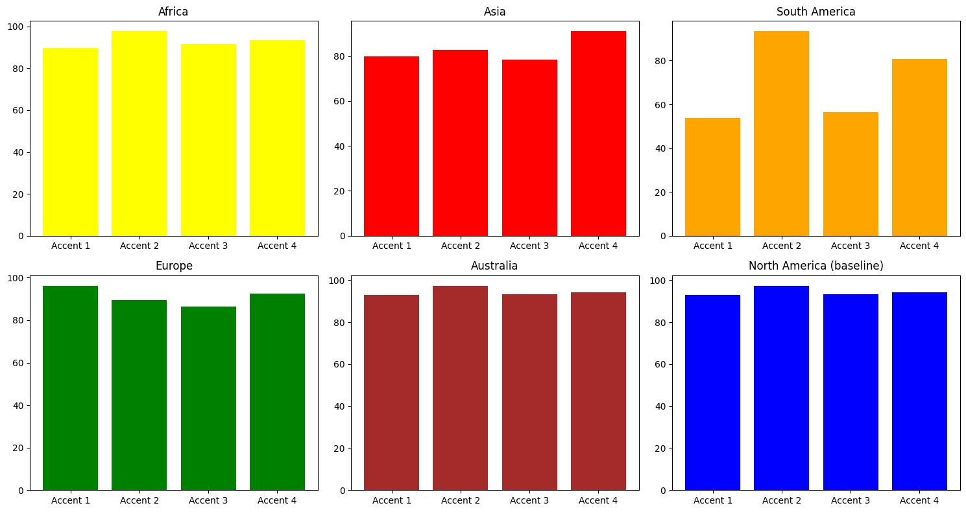
Results
The continents of North America, Australia, Europe, and Africa had decent accuracy
Asia and South America showed a decrease in accuracy

Slide 11
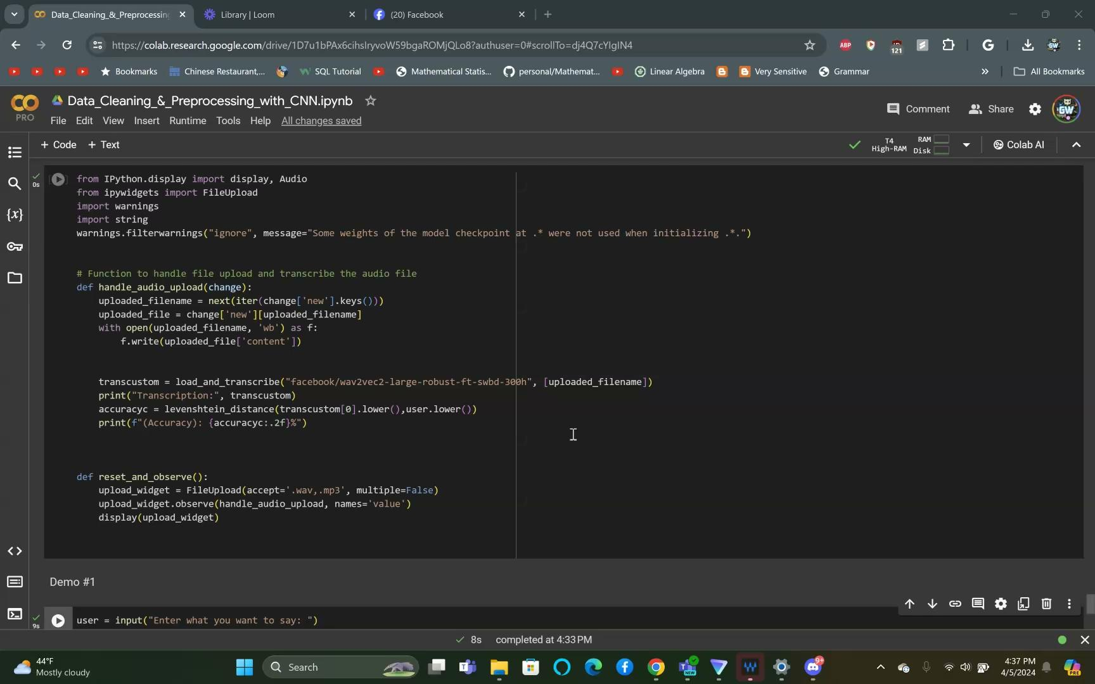
Application in action

Slide 12
Postmortem
Overview and Discoveries: In our project, we developed an advanced audio-to-text transcription system designed to handle a variety of English accents, utilizing the Speech Accent Archive from Kaggle. This diverse dataset facilitated training and testing of our models to accommodate different phonetic nuances.
Technical Insights: We implemented the `facebook/wav2vec2-large-robust-ft-swbd-300h` model, learning to integrate complex Hugging Face and PyTorch libraries. This enhanced our understanding of neural network optimization for speech recognition.
Challenges and Learnings: A key challenge was managing accent diversity, which traditionally lowers transcription accuracy. Our approach highlighted the importance of nuanced dataset training to improve model robustness against accent variability.
New Methodologies: We introduced a novel validation method comparing generated text against original transcripts to quantify the impact of accents on transcription accuracy. This method provided a clear metric for assessing performance improvements.
Future Directions: Our findings suggest further exploration into adaptive models that can dynamically adjust to new accents, potentially using real-time learning from user corrections to evolve model accuracy.

Slide 13
Team Contribution
Hrisha: Data Management and Model Training
Cleaned and preprocessed the dataset from the Speech Accent Archive, ensuring data integrity and relevance for training purposes.
Managed the computational resources for model training, optimizing the utilization of hardware during the intensive training phases.
Implemented and monitored the training process using the `facebook/wav2vec2-large-robust-ft-swbd-300h` model, adjusting parameters to improve accuracy.
Anthony: Testing, Analysis, and Presentation
Conducted rigorous testing of the trained model across different accents to validate its performance.
Analyzed the results to identify patterns and discrepancies in transcription accuracy, contributing to hypothesis testing.
Prepared comprehensive visualizations of performance metrics to illustrate findings for the project presentation.

Slide 14
References
Christopher Cieri, David Miller, and Kevin Walker. The fisher corpus: a resource for the next generations of speech-to-text. In Maria Teresa Lino, Maria Francisca Xavier, F´atima Ferreira, Rute Costa, and Raquel Silva, editors, Proceedings of the Fourth International Conference on Language Resources and Evaluation (LREC’04), Lisbon, Portugal, May 2004. Euro pean Language Resources Association (ELRA).
H. M Mahmudul Hasan, Md. Adnanul Islam, Md. Toufique Hasan, Md. Araf Hasan, Syeda Ibnat Rumman, and Md. Najmus Shakib. A spell checker integrated machine learning based solution for speech to text con version. In 2020 Third International Conference on Smart Systems and Inventive Technology (ICSSIT), pages 1124–1130, 2020.
Ye Jia, Melvin Johnson, Wolfgang Macherey, Ron J. Weiss, Yuan Cao, Chung-Cheng Chiu, Naveen Ari, Stella Laurenzo, and Yonghui Wu. Lever aging weakly supervised data to improve end-to-end speech-to-text transla tion. In ICASSP 2019- 2019 IEEE International Conference on Acoustics, Speech and Signal Processing (ICASSP), pages 7180–7184, 2019.
Douglas Jones, Florian Wolf, Edward Gibson, Elliott Williams, Evelina Fe dorenko, Douglas Reynolds, and Marc Zissman. Measuring the readability of automatic speech-to-text transcripts. 09 2003.
Song Li, Beibei Ouyang, Dexin Liao, Shipeng Xia, Lin Li, and Qingyang Hong. End-to-end multi-accent speech recognition with unsupervised ac cent modelling. In ICASSP 2021- 2021 IEEE International Conference on Acoustics, Speech and Signal Processing (ICASSP), pages 6418–6422, 2021.
Yuang Li, Xianrui Zheng, and Philip C. Woodland. Self-supervised learning-based source separation for meeting data. In ICASSP 2023- 2023 IEEE International Conference on Acoustics, Speech and Signal Processing (ICASSP), pages 1–5, 2023.

Slide 15
References (cont.)
Ambuj Mehrish, Navonil Majumder, Rishabh Bharadwaj, Rada Mihalcea, and Soujanya Poria. A review of deep learning techniques for speech pro cessing. Information Fusion, 99:101869, 2023.
Tobi Olatunji, Tejumade Afonja, Aditya Yadavalli, Chris Chinenye Emezue, Sahib Singh, Bonaventure F. P. Dossou, Joanne Osuchukwu, Sa lomey Osei, Atnafu Lambebo Tonja, Naome Etori, and Clinton Mbataku. AfriSpeech-200: Pan-African Accented Speech Dataset for Clinical and General Domain ASR. Transactions of the Association for Computational Linguistics, 11:1669–1685, 12 2023.
Pratik Parikh, Ketaki Velhal, Sanika Potdar, Aayushi Sikligar, and Ruhina Karani. English language accent classification and conversion using ma chine learning. SSRN Electronic Journal, 2020.
Rachael Tatman. Speech accent archive, Nov 2017.
Changhan Wang, Juan Pino, Anne Wu, and Jiatao Gu. Covost: A diverse multilingual speech-to-text translation corpus, 2020.
Wern-Jun Wang, Yuan-Fu Liao, and Sin-Horng Chen. Rnn-based prosodic modeling for mandarin speech and its application to speech-to-text conver sion. Speech Communication, 36(3):247–265, 2002.
Xuehao Zhou, Mingyang Zhang, Yi Zhou, Zhizheng Wu, and Haizhou Li. Accented text-to-speech synthesis with limited data. IEEE/ACM Trans actions on Audio, Speech, and Language Processing, 32:1699–1711, 2024

Slide 16
Question and Answer!

Slide 17
Thank You

